Slide 1
5 - 18V input
3.3V
3.3V
Voltage Regulator
Digital
switch
signals
3.3V
I2C bus
Rotary Encoders
PIC32MX170F256B
Si4735
I2C bus
128x64 OLED Display
L and R output
to AUX

Slide 2
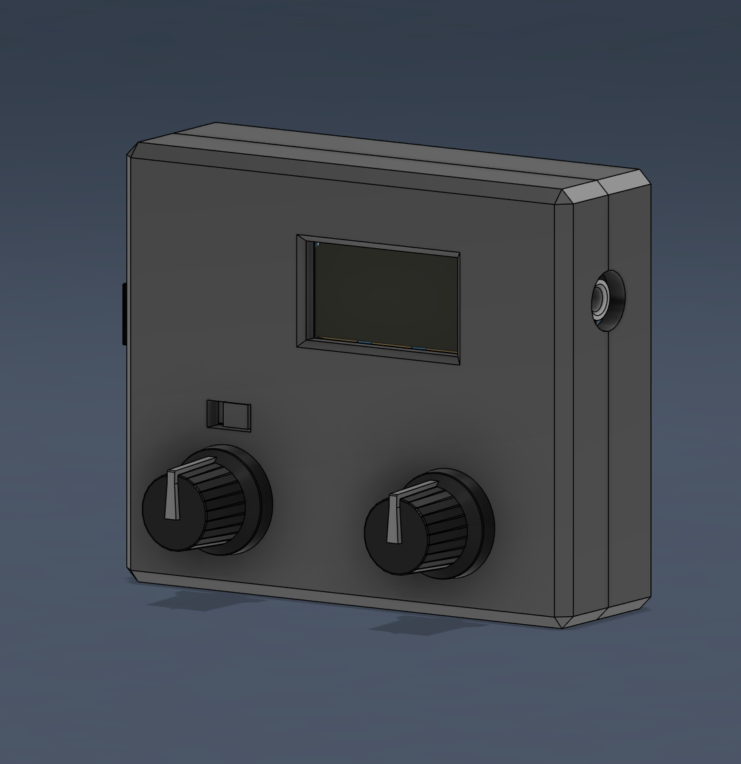
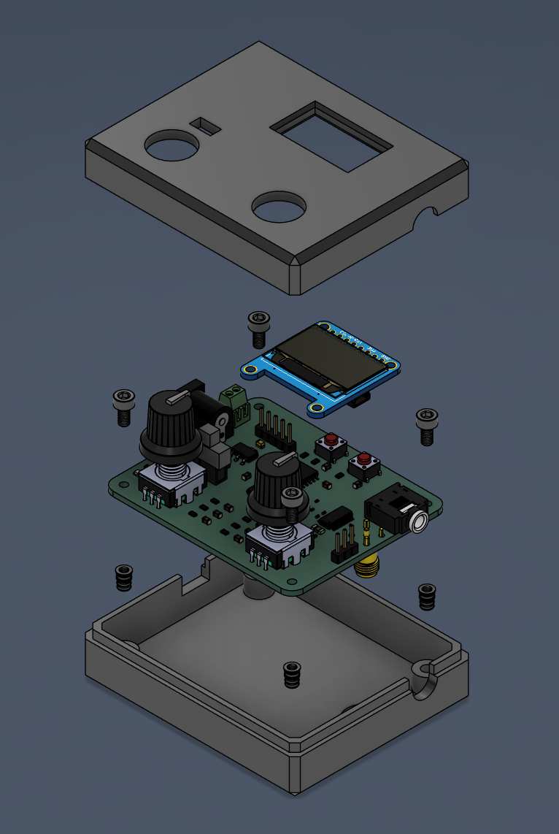

Slide 3
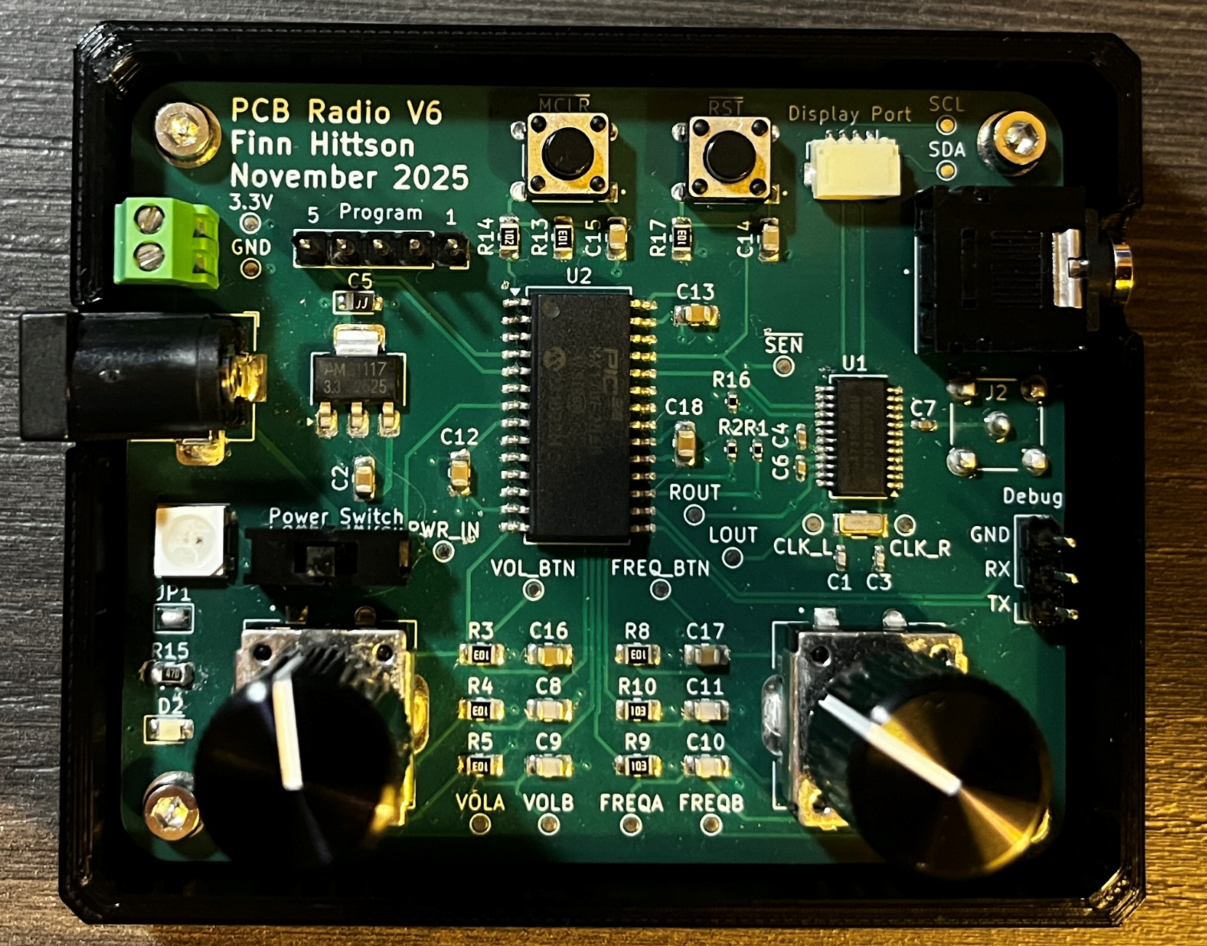
Linear voltage regulator
Distributed power
DC barrel jack
input 5-18V
Distributed power

Slide 4
PIC32MX170F256B
I2C bus for display
I2C bus
for radio
Rotary encoders
3.3V logic level input

Slide 5
L and R audio
output to AUX
Si4735 radio
Antenna
input

